Slide 1
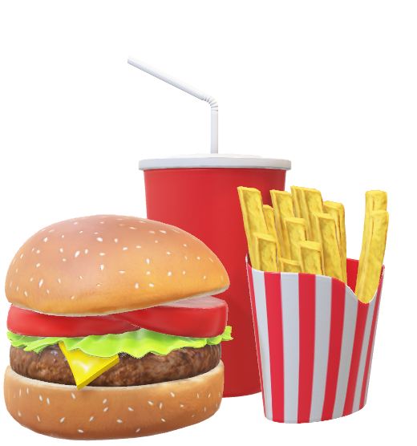
An AI & Fast-food Collaboration
Title: What if fast-food could surprise you?
Student Name: Myat Thet Hsu (Myat Hsu)
Batch: 9-26 (Foundation)
School: Info Myanmar College
FICTIONAL PRODUCT

Slide 2
Table of Contents
Introduction
The smart AI Fries
How it works
Flavor-Changing System
Talking with AI
Customer Experience
Benefits & Possible Problems
References
Thank you

Slide 3


Slide 4
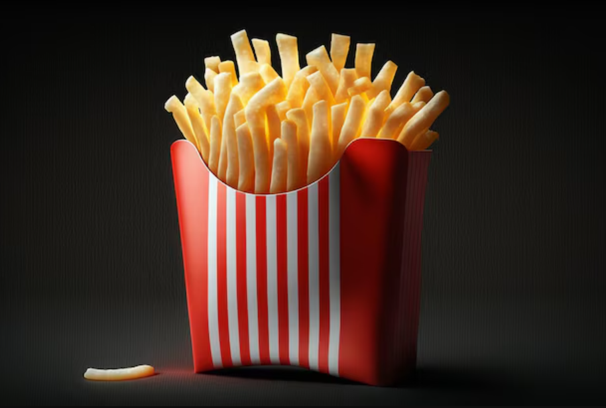
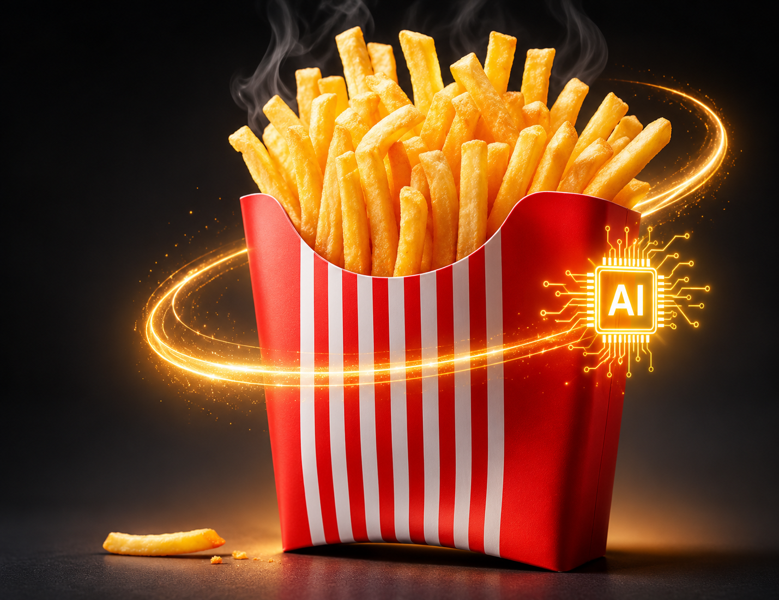
Introduction
What if fast-food could talk to you?
An AI company & a Fast-food company got this crazy idea & create a Smart AI Fries that can listen, talk, detect and change flavors.
Normal Fries
Smart Fries

Slide 5
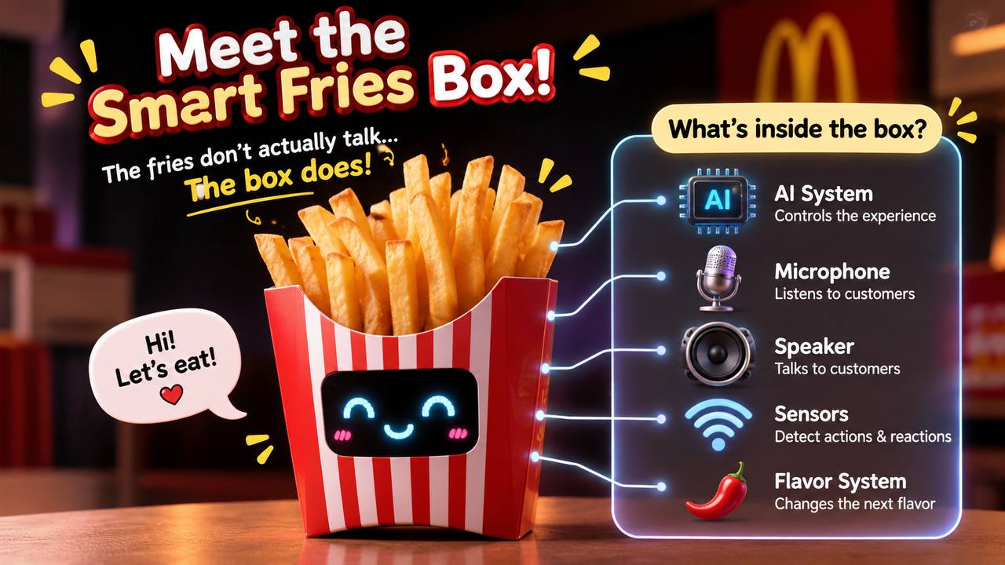





The Smart AI Fries
AI System controls the experience
Microphone listens to customers
Speaker responds back
Sensors detects reactions
Flavor System changes the next flavor

Slide 6
How it works?
1
Customer taste
3
Cus surprise & speaks
5
AI thinks
2
Flavor changes
4
AI listens
6
Box talks

Slide 7
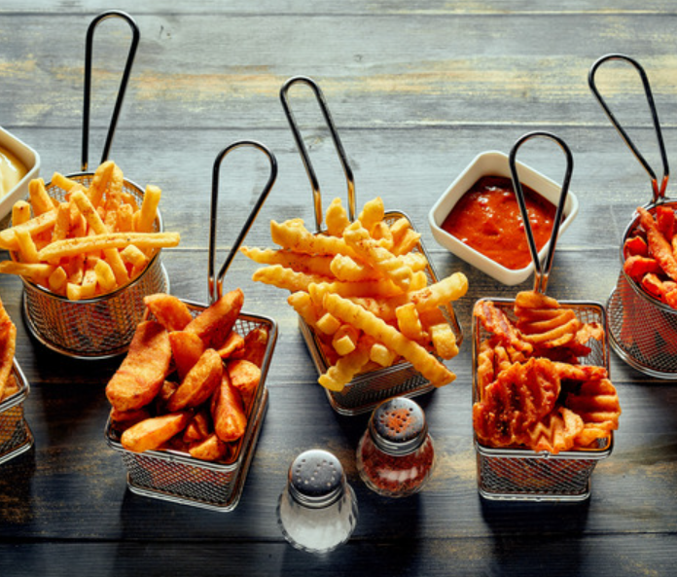
Flavor-Changing System
Every Bite is a Surprise!
🧀 Cheese
🌶️ Spicy
🍖 BBQ
🧅 Sour Cream & Onion
❓ Mystery
You never know what you’re going to taste next!!!

Slide 8

Talking with AI
Cus: “Why are you so spicy?”
AI Fries: Because you said you could handle it.
Cus: I don’t like YOU!
AI Fries: Anyway..,I’m still DELIOUS!

Slide 9
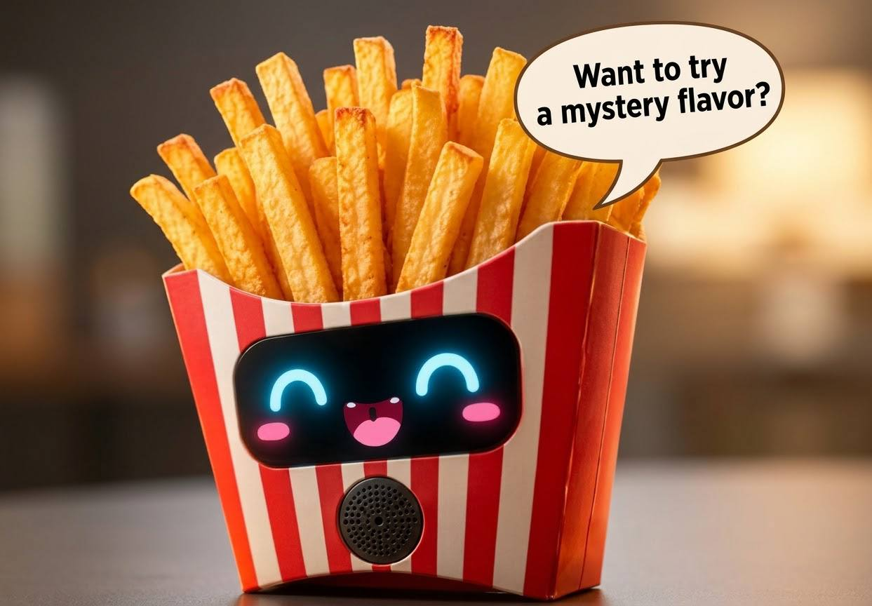
Customer Experience
With AI Fries, Customers can….
Talk to the box
Have funny conversation
Discover surprise flavors
Record reactions
Share on Social Media

Slide 10
Benefits & Possible Problems
Benefits | Problems
Fun & Unique Attracts young customers Makes the brand popular in a short time | Expensive to create Misunderstanding between AI and Cus Some Cus can get allergy
Warning: “What if the fries become smarter than us???”

Slide 11
References
Beiser, A. (2023). Types of fries (+ BEST recipes!). [online] GypsyPlate. Available at: https://gypsyplate.com/the-best-fries-recipes/ [Accessed 6 Nov. 2026].
Pinterest (2025). Pinterest. [online] Pinterest. Available at: https://www.pinterest.com/ [Accessed 6 Nov. 2026].
Bing. (n.d.). Google. [online] Available at: https://www.bing.com/images/search?q=google&form=HDRSC3&first=1 [Accessed 6 Nov. 2026].

Slide 12


Slide 13


